Slide 1
6.Seven Segment Display
using ARDUINO
Dr. G. V. Prasanna Anjaneyulu

Slide 2
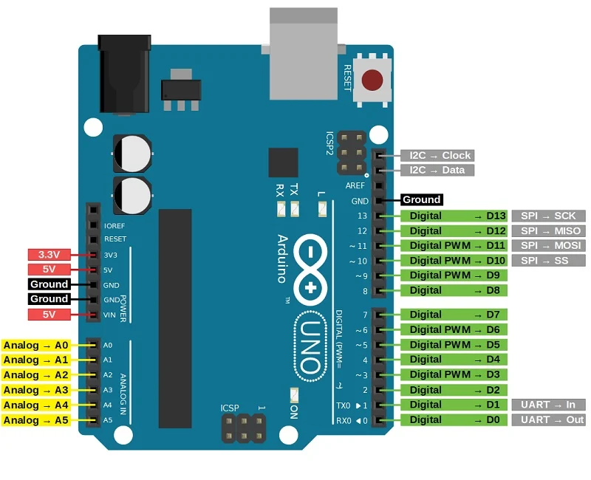
Dr. G. V. Prasanna Anjaneyulu
Seven_Segment_Display by Dr.GVP

Slide 3
Apparatus
1.PC with Arduino IDE
2.Arduino UNO Board
3.USB cable
4.Seven Segment Display [SSD]
5.Bread board
6.1kΩ resistor
7.Jumper wires
Dr. G. V. Prasanna Anjaneyulu
Seven_Segment_Display by Dr.GVP

Slide 4
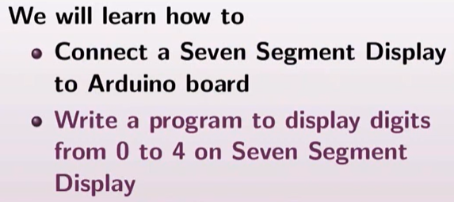
Dr. G. V. Prasanna Anjaneyulu

Slide 5
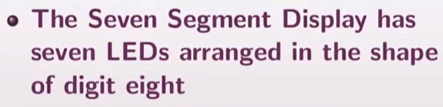
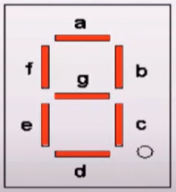
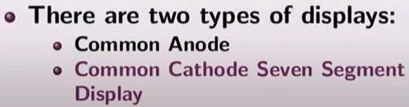
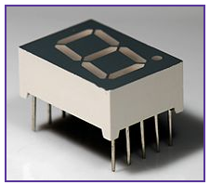
Dr. G. V. Prasanna Anjaneyulu

Slide 6
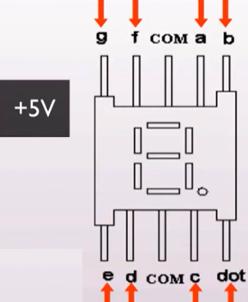
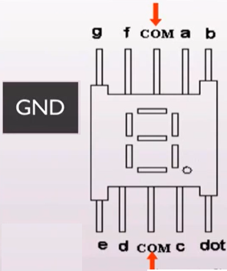
Common-Cathode [CC]
Dr. G. V. Prasanna Anjaneyulu

Slide 7
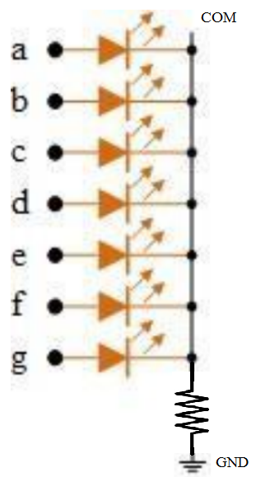
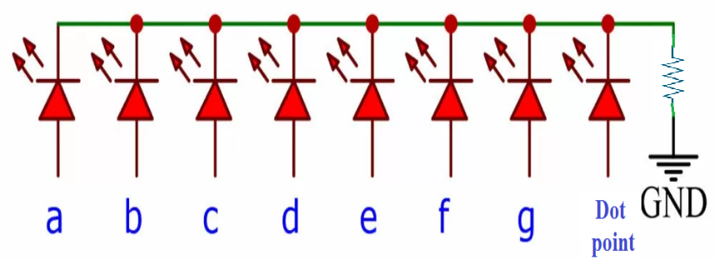
Contd….
COM
Dr. G. V. Prasanna Anjaneyulu

Slide 8
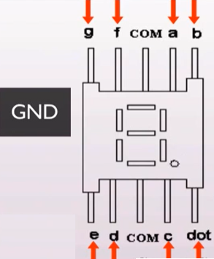
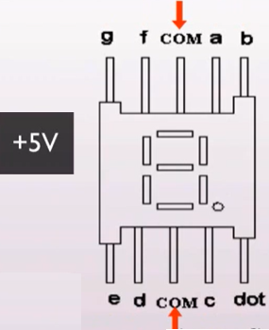
Common-Anode [CA]
Dr. G. V. Prasanna Anjaneyulu

Slide 9
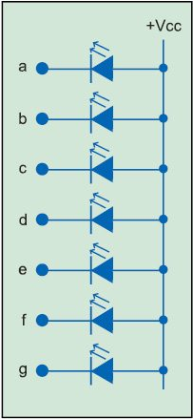
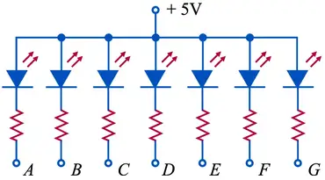
Contd….
Dr. G. V. Prasanna Anjaneyulu

Slide 10
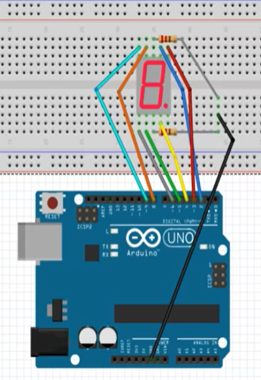
Implementation [CC]
Dr. G. V. Prasanna Anjaneyulu

Slide 11
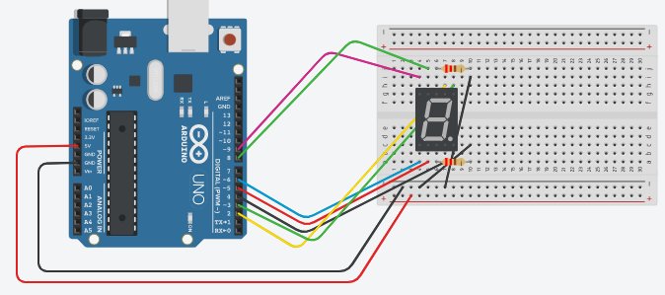
Dr. G. V. Prasanna Anjaneyulu

Slide 12
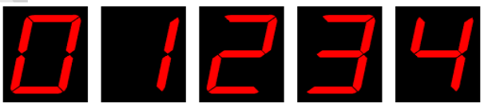
Numbers
Dr. G. V. Prasanna Anjaneyulu

Slide 13
Program
#define a 2 //connecting segment a to PIN2
#define b 3 //connecting segment b to PIN3
#define c 4 //connecting segment c to PIN4
#define d 5 //connecting segment d to PIN5
#define e 6 //connecting segment e to PIN6
#define f 8 //connecting segment f to PIN8
#define g 9 //connecting segment g to PIN9
void setup()
{
pinMode(a, OUTPUT);
pinMode(b, OUTPUT);
pinMode(c, OUTPUT);
pinMode(d, OUTPUT);
pinMode(e, OUTPUT);
pinMode(f, OUTPUT);
pinMode(g, OUTPUT);
}
Dr. G. V. Prasanna Anjaneyulu

Slide 14
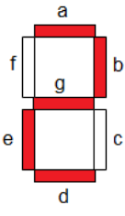
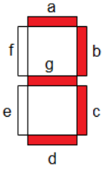
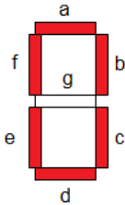
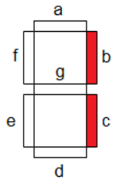
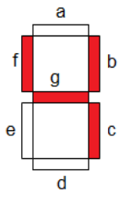
Contd….
void loop()
{
//ZERO
digitalWrite(a,HIGH);
digitalWrite(b,HIGH);
digitalWrite(c,HIGH);
digitalWrite(d,HIGH);
digitalWrite(e,HIGH);
digitalWrite(f,HIGH);
digitalWrite(g,LOW);
delay(1000);
//ONE
digitalWrite(a,LOW);
digitalWrite(b,HIGH);
digitalWrite(c,HIGH);
digitalWrite(d,LOW);
digitalWrite(e,LOW);
digitalWrite(f,LOW);
digitalWrite(g,LOW);
delay(1000);
//TWO
digitalWrite(a,HIGH);
digitalWrite(b,HIGH);
digitalWrite(c,LOW);
digitalWrite(d,HIGH);
digitalWrite(e,HIGH);
digitalWrite(f,LOW);
digitalWrite(g,HIGH);
delay(1000);
//THREE
digitalWrite(a,HIGH);
digitalWrite(b,HIGH);
digitalWrite(c,HIGH);
digitalWrite(d,HIGH);
digitalWrite(e,LOW);
digitalWrite(f,LOW);
digitalWrite(g,HIGH);
delay(1000);
//FOUR
digitalWrite(a,LOW);
digitalWrite(b,HIGH);
digitalWrite(c,HIGH);
digitalWrite(d,LOW);
digitalWrite(e,LOW);
digitalWrite(f,HIGH);
digitalWrite(g,HIGH);
delay(1000);
}
Dr. G. V. Prasanna Anjaneyulu

Slide 15

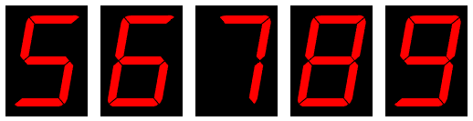

Dr. G. V. Prasanna Anjaneyulu

Slide 16
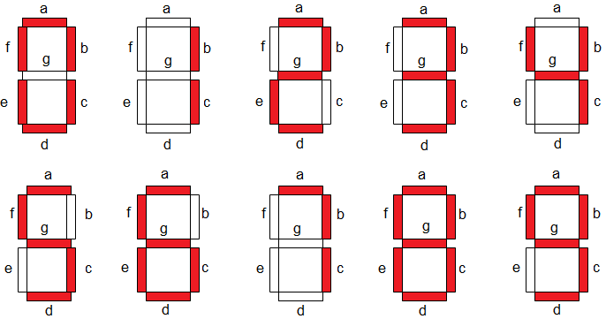
Dr. G. V. Prasanna Anjaneyulu

Slide 17
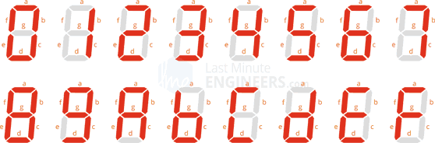
Dr. G. V. Prasanna Anjaneyulu

Slide 18


